Slide 1
SDS Workshop
Ginny Lister

Slide 2
Enabling Objective
Given sample data, participants will be able to:
Enter assignment columns
Define types of assignments
Set assignment points
Enter student scores

Slide 3
Activate
Why do we need a new grade program?
Students and parents need current grade information.
Teachers need a user-friendly grade program.
Everyone benefits!

Slide 4
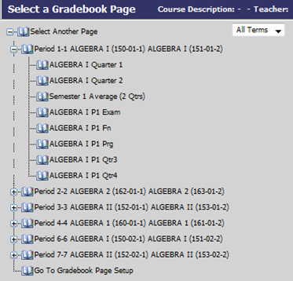
Demonstration
Select a course and gradebook.

Slide 5
Demonstrate
Quick Add Columns
Click on the Quick Add icon.

Slide 6
Demonstration
Enter the following information:
Name of assignment (Heading)
Description of assignment (optional)
Date of assignment
Due date
Points
Category (test, daily work, extra credit etc.)

Slide 7
Demonstrate
These items are already set up for you.
Marking period
Parent Connect (uncheck if you do not want it to show on Parent Connect for each of your assignments).

Slide 8
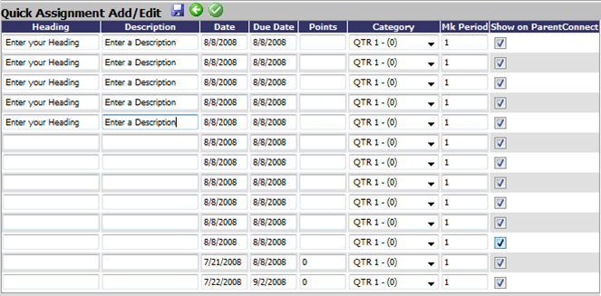
Demonstration

Slide 9
Application
Using the following sample data, enter the two sample assignments into the class labeled “Practice”.
Save the entered data.
Return to the class page (green arrow) and look at the calculated grades.

Slide 10
Application – Sample Data
Map skills worksheet 12
Daily work category
Assigned 12/04/08
Due 12/05/08
100 points possible
Student scores:
Joey 89
Sam 76
Sally 82
Jeff 100
Noel 67
Judy 98
Wyatt 88

Slide 11
Application – Sample Data
Chapter 4 Test
Assigned 12/05/08
Due 12/05/08
Test category
100 points possible
Joey 97
Sam 82
Sally 77
Jeff 98
Noel 79
Judy 100
Wyatt 92

Slide 12
Integration
Now we get to do this for real!
Enter your assignments from the first two weeks of class.
Enter student scores.
Look! Your grades are automatically calculated!

Slide 13
Celebrate!
You now can add your own assignments and student scores to your online gradebook.
Congratulations !

